Slide 1
Lecture 10-12: Language Models
USC VSoE CSCI 544: Applied Natural Language Processing
Jonathan May -- 梅約納
September 27-October 4, 2017
based on slides of Nathan Schneider / Sharon Goldwater

Slide 2
Quiz 1
Which of the following CFG rules are in CNF (assume capital letters signify nonterminals, lowercase letters signify terminals)?
S -> NP VP
NP -> NP PP
NP -> DT JJ NN
NP -> the boy
NP -> PP
JJ -> red
NP -> the NP

Slide 3
Quiz 2
What is the next step?
shift
reduce
LArc
RArc
LArc-det
RArc-det
RArc-nmod
LArc-nmod

Slide 4
Please turn your homework ...
What word comes next?
in
over
into
the
refrigerator
What are the probabilities of each of these?
And why should we care?

Slide 5
Probability of a sentence; P(s)
How likely is it to occur?
Colloquially, how likely is any speaker of language X to utter s?
P(the cat slept peacefully) > P(slept the peacefully cat)
P(she studies morphosyntax) > P(she studies more faux syntax)

Slide 6
Language Models in NLP
It's very difficult to know the true P(s) for an arbitrary sequence of words
But we can define a language model that will give us good approximations
Language models (LMs) are very useful whenever we are generating output
Machine Translation
Spelling Correction
Summarization
Speech Recognition
There are some very good, easy-to-use toolkits for building and using LMs
SRILM: around since the 90s. not advised with >300m tokens
KenLM: preferred choice; great scalability in memory and time with even billions of tokens
NLTK has some LM training/using support (ok for prototyping)

Slide 7
Use of Language Models: Spelling Correction
no much effect
so much effort
no much effort
not much effort
...
input
Error Model
LanguageModel
no much effort
not much effort

Slide 8
Use of Language Models: Speech Recognition
input
She studies morphosyntax
She studies more faux syntax
She's studies morph or syntax
...
Acoustic Model
LanguageModel
she studies morphosyntax

Slide 9
Use of Language Models: Machine Translation
input
ella se va a casa
She is going home
She is going house
She goes to home
To home she is going
...
TranslationModel
Language Model
she is going home

Slide 10
LMs for Prediction
LMs can be used to predict what a human will do next, rather than correct a possibly faulty model
Example: predictive text correction/completion on your phone
Keyboard is tiny, so it's easy to touch a spot slightly off from the letter you intend
Correct these errors as you go and also provide possible completions
In this case, LM may be defined over sequences of characters instead of (or in addition to) sequences of words
i
n
e
f
f
i
cient

Slide 11
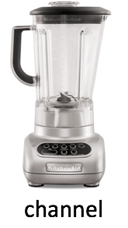


Noisy Channel Model
P(S)
P(W|S)
S
"corruption" of S
W
an english sentence
decode

Slide 12
But How To Estimate These Probabilities?
We want to to know the probability of word sequence w = w₁, w₂, ..., w_{n} occurring in English
Assume we have some training data: large corpus of general English text
We use this data to estimate the probability of w (even if we never see it in the corpus)

Slide 13
Bit of Notation: Random Variables
Random Variable = variable that represents all the possible events in some partition of Ω
So if X is a coin flip I can say P(X=heads) to mean probability the flip comes up heads or just P(X) to mean the probability table for the events (heads, tails)
We can treat Random Variables like events
Flip coin A. Independently, flip coin B
P(A=heads | B=tails) = P(A=heads); A=heads and B=tails are independent events
for all x in {heads, tails}, for all y in {heads, tails}, P(A=x | B=y) = P(A=x); A and B are independent random variables
We've been using Random Variables all along, actually, but have been a bit sloppy
(I probably should have discussed these back in Lecture 4)

Slide 14
Probability of a word sequence
P(w) = P(w₁, w₂, w₃, w₄, ..., w_{n})
e.g. P(w = the cat slept quietly) = P(w₁=the, w₂=cat, w₃⁼ slept, w₄=quietly)
We'll often abuse notation when talking about specific events and context is clear, e.g. P(the cat slept quietly)

Slide 15
Maximum Likelihood Estimation?
Recall Maximum Likelihood Estimations (MLE) for our HMM POS tagger
AKA "Count and divide"
So get a corpus of N sentences
P_{MLE}(w = the cat slept quietly) = C(the cat slept quietly)/N
But consider these sentences:
the long-winded peripatetic beast munched contentedly on mushrooms
parsimonius caught the of about for syntax
Neither is in a corpus (I just made them up), so P_{MLE}=0 for both
But one is meaningful and grammatical and the other isn't!

Slide 16
Sparse Data and MLE
If something doesn't occur, MLE thinks it can't occur
No matter how much data you get, you won't have enough observations to model all events well with MLE
We need to make some assumptions so that we can provide a reasonable probability for grammatical sentences, even if we haven't seen them

Slide 17
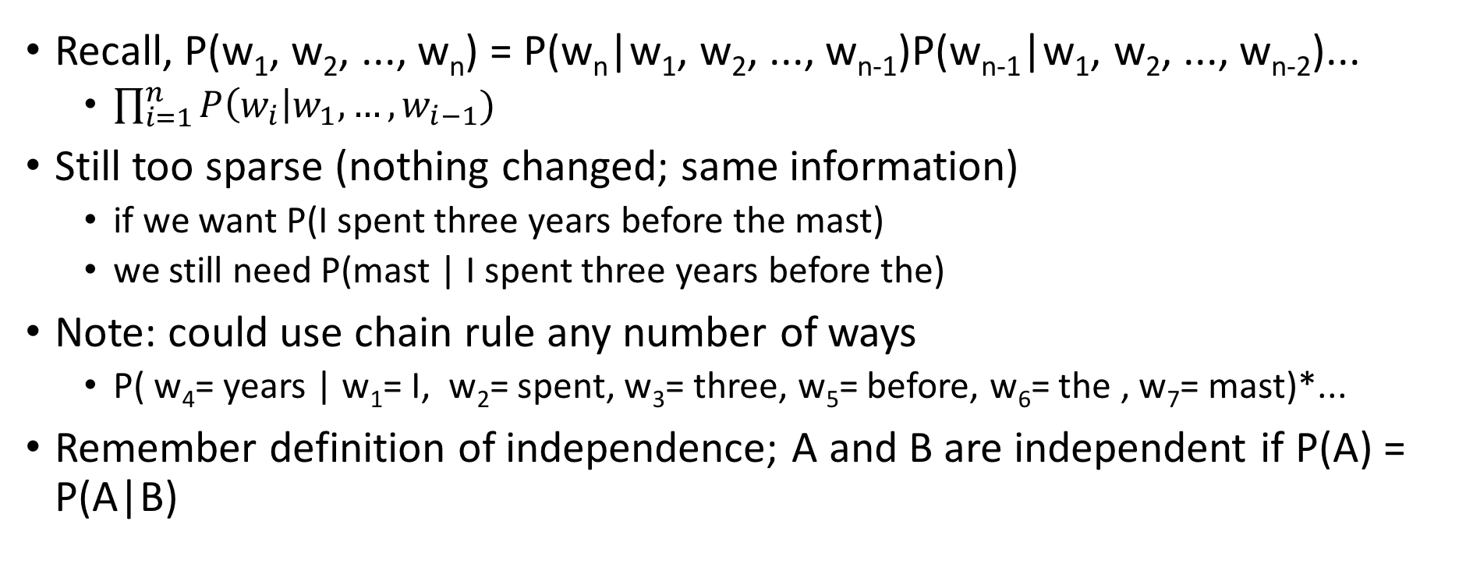
Independence (Markov) Assumption
Recall, P(w₁, w₂, ..., w_{n}) = P(w_{n}|w₁, w₂, ..., w_{n-1})P(w_{n-1}|w₁, w₂, ..., w_{n-2})...
$\prod_{i=1}^{n}{P\left(w_{i}\right|w_{1},…, w_{i−1})}$
Still too sparse (nothing changed; same information)
if we want P(I spent three years before the mast)
we still need P(mast | I spent three years before the)
Note: could use chain rule any number of ways
P( w₄= years | w₁= I, w₂= spent, w₃= three, w₅= before, w₆= the , w₇= mast)*...
Remember definition of independence; A and B are independent if P(A) = P(A|B)

Slide 18
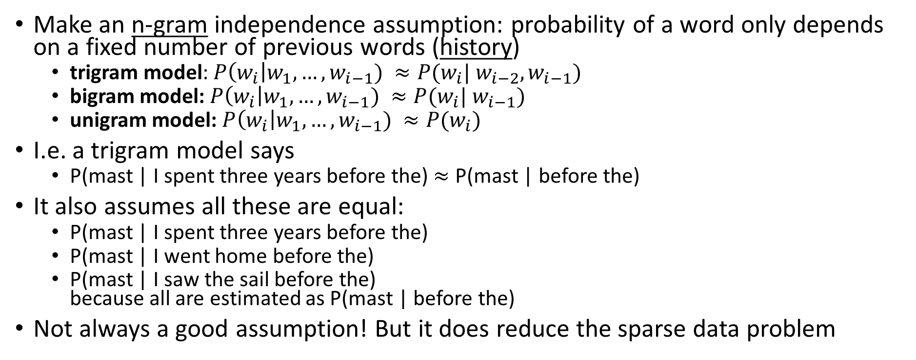
Independence (Markov) Assumption
Make an n-gram independence assumption: probability of a word only depends on a fixed number of previous words (history)
trigram model: $P\left(w_{i}\right|w_{1},…, w_{i−1}) ≈P(w_{i}| w_{i−2}, w_{i−1})$
bigram model: $P\left(w_{i}\right|w_{1},…, w_{i−1}) ≈P(w_{i}| w_{i−1})$
unigram model: $P\left(w_{i}\right|w_{1},…, w_{i−1}) ≈P(w_{i})$
I.e. a trigram model says
P(mast | I spent three years before the) $≈$ P(mast | before the)
It also assumes all these are equal:
P(mast | I spent three years before the)
P(mast | I went home before the)
P(mast | I saw the sail before the) because all are estimated as P(mast | before the)
Not always a good assumption! But it does reduce the sparse data problem

Slide 19
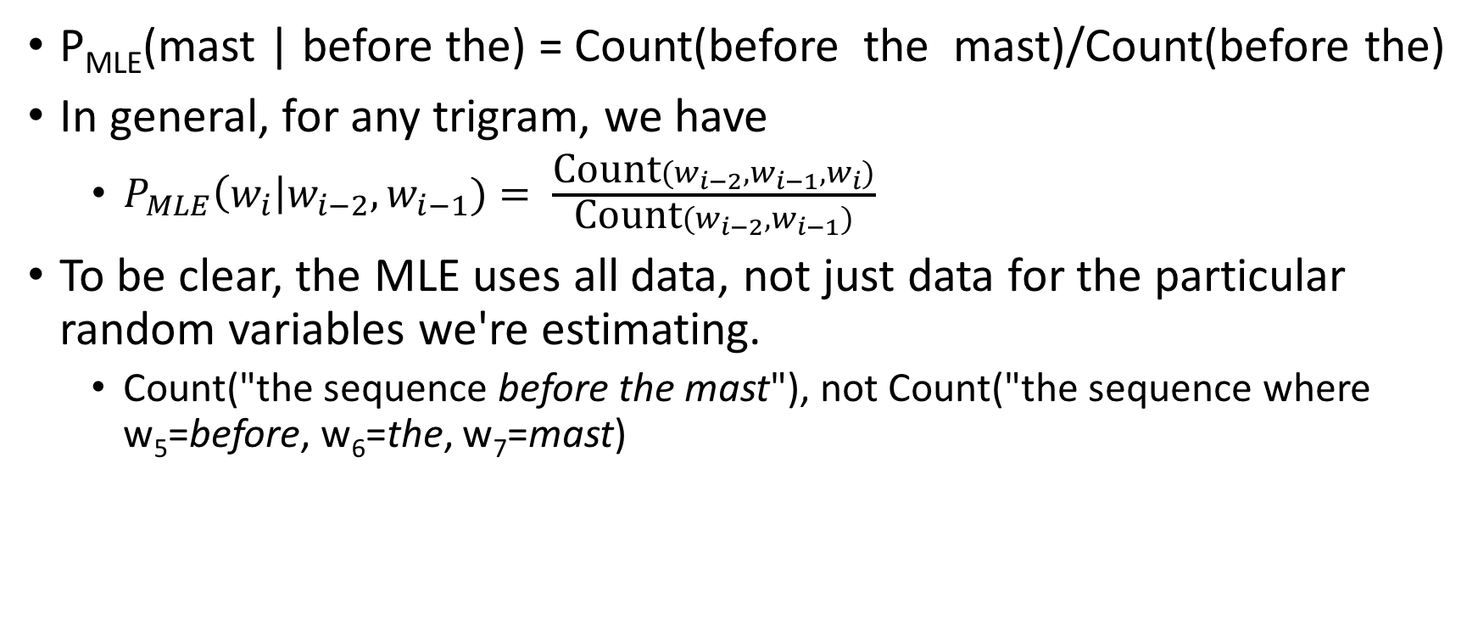
Estimating Trigram Conditional Probabilities
P_{MLE}(mast | before the) = Count(before the mast)/Count(before the)
In general, for any trigram, we have
$P_{MLE}\left(w_{i}\right|w_{i−2}, w_{i−1})= \frac{\text{Count}(w_{i−2}{,w}_{i−1},w_{i})}{\text{Count}(w_{i−2},w_{i−1})}$
To be clear, the MLE uses all data, not just data for the particular random variables we're estimating.
Count("the sequence before the mast"), not Count("the sequence where w₅=before, w₆=the, w₇=mast)

Slide 20
Example from Moby Dick corpus
C(before, the) = 25; C(before, the, mast) = 4
C(before, the, mast) / C(before, the) = 0.16
mast is the most common word to come after "before the" (wind is second most common)
P_{MLE}(mast) = 56/110927 = .0005 and P_{MLE}(mast|the) = .003
Seeing "before the" vastly increases the probability of seeing "mast" next

Slide 21
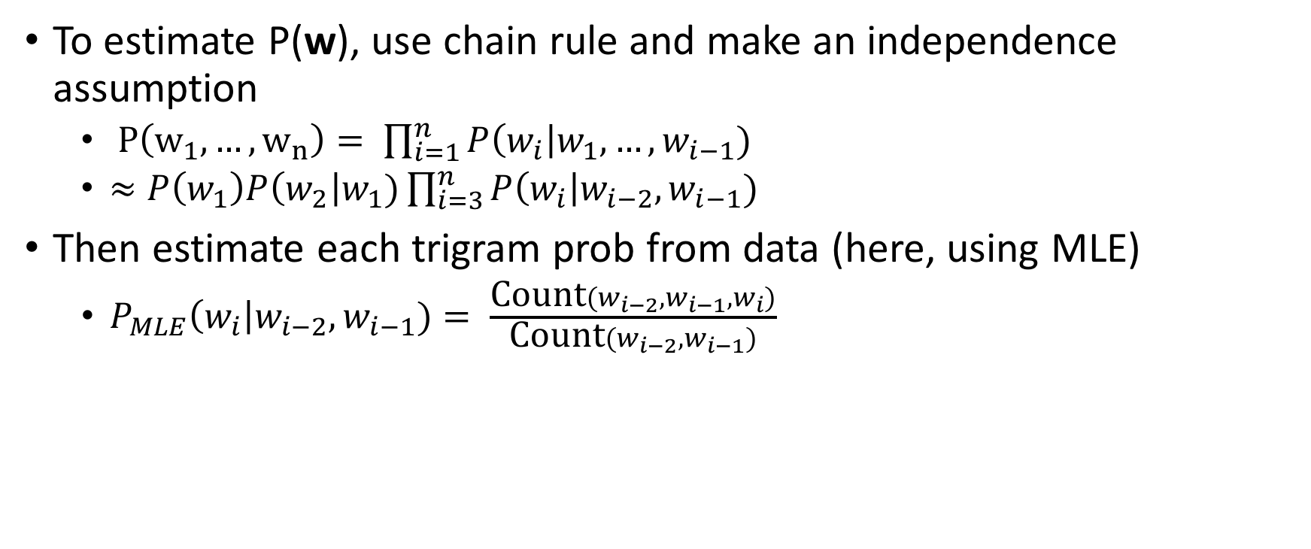
Trigram model summary
To estimate P(w), use chain rule and make an independence assumption
$P\left(w_{1}, …, w_{n}\right)= \prod_{i=1}^{n}{P\left(w_{i}\right|w_{1},…, w_{i−1})}$
$≈P\left(w_{1}\right)P\left(w_{2}\right|w_{1})\prod_{i=3}^{n}{P\left(w_{i}\right|w_{i−2},w_{i−1})}$
Then estimate each trigram prob from data (here, using MLE)
$P_{MLE}\left(w_{i}\right|w_{i−2}, w_{i−1})= \frac{\text{Count}(w_{i−2}{,w}_{i−1},w_{i})}{\text{Count}(w_{i−2},w_{i−1})}$

Slide 22
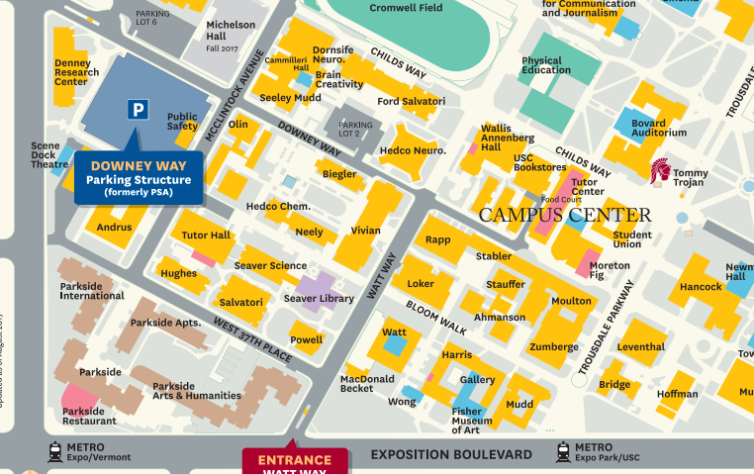
Midterm Info
Some of you will
NOT BE IN SAL 101
YOU WILL BE
IN MHP (Mudd) 101

Slide 23
Who is Where?
If your last* name is from Aggarwal to Patel, you are in SAL 101
If it is from Pathapi to Zhu, you are in MHP 101
* "last" is a very Eurocentric term. I have an alphabetization based on what USC has your surname listed as.
To avoid confusion, please check the course website, which has a very prominent link to a roster with firstname, last name, partially masked email address, and assignment
If you are still unsure of where to go, contact us on piazza ASAP

Slide 24
Midterm Logistics
Length: 1 hour, 40 minutes (you will need time to set up and hand in exam)
Date: Friday, October 6, 8:00 AM (Please arrive promptly!)
Please Bring:
Pencils/pens/erasers as needed
one 8.5x11 inch (or A4) sheet of paper with notes on both sides (optional)
NO OTHER NOTES
NO ELECTRONIC RESOURCES
NO BOOKS
We will provide extra paper for scratch work
Sit only at seats with exams on them. Fill up all available space.

Slide 25
What's On The Exam?
Fair game
Anything on the slides
Anything in the required reading
Anything in the homeworks
But
We're not trying to trick you
We're not trying to make this impossible
If you understand the lectures well, you should be ok

Slide 26
What's On The Exam
Major Topics
Levels of Linguistic Knowledge (L1)
Corpora, Regex, Basic text processing (L2)
Morphology, Finite State Automata and Transducers (L3)
Probability Theory (L4)
Naive Bayes, Features, Perceptron, Logistic Regression (L5)
POS Tagging and HMM tagger, Viterbi Decoding (L6)
Constituency Syntax Trees, Context-Free Grammars, CKY, CNF, Smoothing, Interpolating, Beam Decoding (L7-8)
Dependency Syntax Trees, Arc-Standard and Arc-Eager Dependency Parsing (L9-10)
Ngram Language Models, Smoothing, Backoff, Interpolation, alternate language models (L10-11) (Probably no neural; depends on how far we get)
It won't all be on there because there isn't enough time
But there is plenty of room on the final

Slide 27
Practical details (I)
Trigram model assumes two-word history
But consider these sentences:
What's wrong?
a sentence shouldn't end with 'yellow'
a sentence shouldn't begin with 'feeds'
Does the model capture these problems?
w₁ | w₂ | w₃ | w₄
he | saw | the | yellow
feeds | the | cats | daily

Slide 28
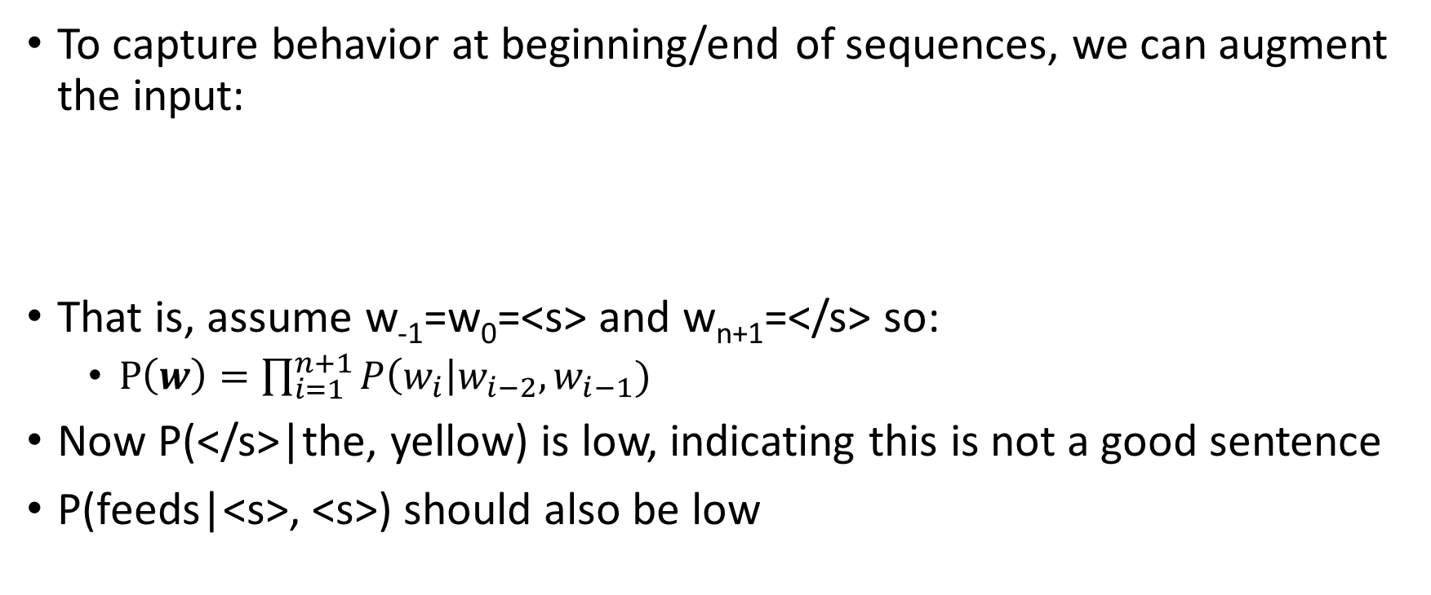
Beginning / end of sequence
To capture behavior at beginning/end of sequences, we can augment the input:
That is, assume w₋₁=w₀=<s> and w_{n+1}=</s> so:
$P\left(w\right)=\prod_{i=1}^{n+1}{P\left(w_{i}\right|w_{i−2},w_{i−1})}$
Now P(</s>|the, yellow) is low, indicating this is not a good sentence
P(feeds|<s>, <s>) should also be low
w₋₁ | w₀ | w₁ | w₂ | w₃ | w₄ | w₅
<s> | <s> | he | saw | the | yellow | </s>
<s> | <s> | feeds | the | cats | daily | </s>

Slide 29
Beginning/end of sequence
Alternatively, we could model all sentences as one (very long) sequence, including punctuation
two cats live in sam 's barn . sam feeds the cats daily . yesterday , he saw the yellow cat catch a mouse . [...]
Now, trigram probabilities like P(. | cats daily) and P(, | . yesterday) tell us about behavior at sentence edges
Here, all tokens are lowercased. What are the pros/cons of not doing that?

Slide 30
Practical details (II)
Word probabilities are typically very small.
Multiplying lots of small probabilities quickly gets so tiny we can't represent the numbers accurately, even with double precision floating point.
So in practice, we typically use log probabilities (usually base-e)
Since probabilities range from 0 to 1, log probs range from -∞ to 0
Instead of multiplying probabilities, we add log probs
Often, negative log probs are used instead; these are often called "costs"; lower cost = higher prob
Recall: we saw this with bigram HMM for POS tagging

Slide 31
Interim Summary: N-gram probabilities
"Probability of a sentence": how likely is it to occur in natural language?
We can never know the true probability, but we may be able to estimate it from corpus data.
N-gram models are one way to do this:
To alleviate sparse data, assume word probs depend only on short history
Tradeoff: longer histories may capture more, but are also sparser
So far, we estimated N-gram probabilities using MLE

Slide 32
Interim Summary: Language Models
Language Models tell us P(w) = P(w₁, ..., w_{n}): How likely is this sequence of words to occur?
Roughly: Is this sequence of words a "good" one in my language?
LMs are used as a component in applications such as speech recognition, machine translation, and predictive text completion
To reduce sparse data, N-gram LMs assume words depend only on a fixed-length history, even though we know this isn't true
Next:
How to evaluate a language model
Weaknesses of MLE and how to address them (more sparsity)

Slide 33
Quiz 3
Which of These Statements are True?
Naive Bayes is a probabilistic model
Perceptron is a generative model
Logistic regression has a closed-form solution
Logistic regression is a discriminative model

Slide 34
Two Types of Evaluation in NLP
Extrinsic: measure performance on a downstream application
For LM, plug it into a machine translation/ASR/etc system
The most reliable and useful evaluation: We don't use LMs absent other technology
But can be time-consuming
And of course we still need an evaluation measure for the downstream system
Intrinsic: design a measure that is inherent to the current task
much quicker/easier during development cycle
not always easy to figure out what the right measure is. Ideally, it's one that correlates with extrinsic measures

Slide 35
Intrinsically Evaluating a Language Model
For parsing, tagging, sentiment, etc. it was fairly clear how to evaluate: Hold a set of labeled data out and see how often your model gets it right
For LM, it's not quite so clear
Given a corpus of sentences and non-sentences, see how often the LM thinks you have a sentence?
Not a very realistic evaluation of how an LM is used
Often we are deciding between not-that-grammatical outputs
Ideally we want a regression evaluation
Given a sentence, how close is the model probability to the true probability
But we don't know the true probability of a sentence!

Slide 36
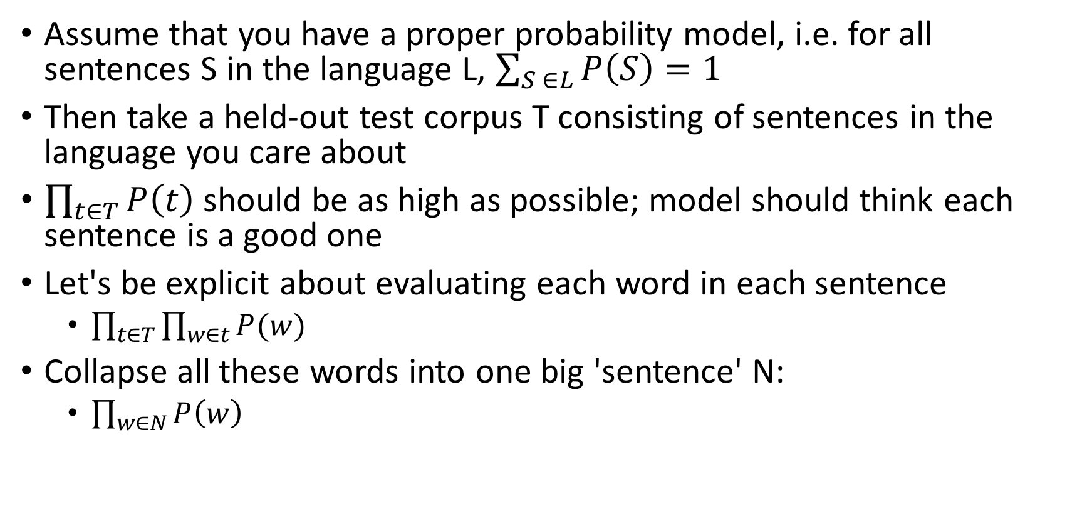
Idea: Model should give high probability to an unseen corpus
Assume that you have a proper probability model, i.e. for all sentences S in the language L, $\sum_{S ∈L}{P\left(S\right)=1}$
Then take a held-out test corpus T consisting of sentences in the language you care about
$\prod_{t∈T}{P\left(t\right)}$ should be as high as possible; model should think each sentence is a good one
Let's be explicit about evaluating each word in each sentence
$\prod_{t∈T}{\prod_{w∈t}{P(w)}}$
Collapse all these words into one big 'sentence' N:
$\prod_{w∈N}{P\left(w\right)}$

Slide 37
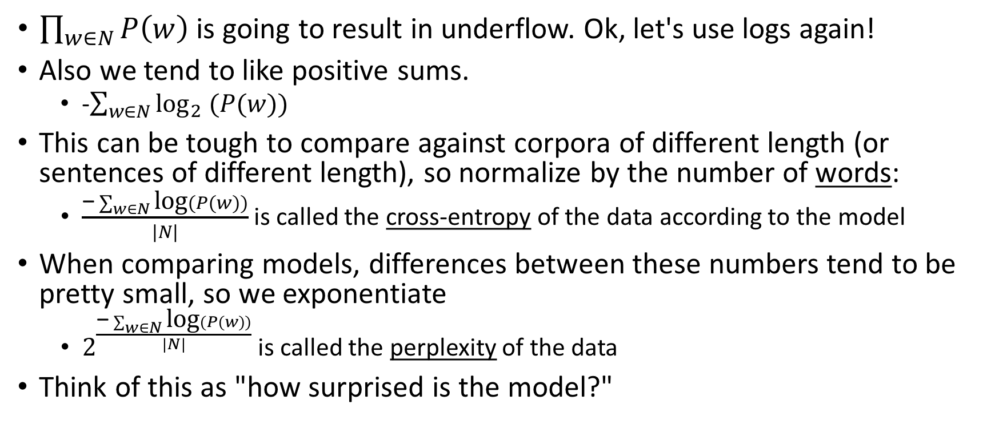
Resolving Some Problems
$\prod_{w∈N}{P\left(w\right)}$ is going to result in underflow. Ok, let's use logs again!
Also we tend to like positive sums.
-$\sum_{w∈N}{{\text{log}}_{2} (P(w))}$
This can be tough to compare against corpora of different length (or sentences of different length), so normalize by the number of words:
$\frac{\text{−}\sum_{w∈N}{\text{log}(P(w))}}{|N|}$ is called the cross-entropy of the data according to the model
When comparing models, differences between these numbers tend to be pretty small, so we exponentiate
$2^{\frac{\text{−}\sum_{w∈N}{\text{log}(P(w))}}{|N|}}$ is called the perplexity of the data
Think of this as "how surprised is the model?"

Slide 38
Example
Three word sentence with probabilities ¼ , ½, ¼
¼ * ½ * ¼ = .03125
cross-entropy: -(log(1/4) + log(1/2) + log(1/4))/3 = 5/3; 2^{5/3} ≈3.17
Six word sentence with probabilities ¼, ½, ¼, ¼, ½, ¼
¼ * ½ * ¼ * ¼ * ½ * ¼ = .00097
log facts: log₂(1/4) = -2; log₂(1/2) = -1
cross-entropy: -(log(1/4) + log(1/2) + log(1/4) + log(1/4) + log(1/2) + log(1/4))/6 = 10/6; 2^{10/6} ≈3.17
If you overfit your training corpus so that P(train) = 1, then Perplexity on train is 0
But Perplexity on test (which doesn't overlap with train) will be infinite

Slide 39
Intrinsic Evaluation Big Picture
Lower Perplexity is better
Roughly = number of bits needed to communicate information about a word
The terms 'cross-entropy' and 'perplexity' come out of information theory; it's in the reading if you're interested but we won't dwell on it
In principle you could compare on different test sets
In practice, domains shift. To know which of two LMs is better, train on common training sets, test on common test sets

Slide 40
Sparse data, again
Suppose we build a trigram model from Moby Dick and evaluate the sentence "I spent three years before the mast"
"I spent three" never occurs in training, so P_{MLE}(three|I spent) = 0
so cross-entropy is infinite
This is basically right; our model says "I spent three" should never occur so when it does our model is infinitely surprised!
Even with a unigram model we run into words we never saw, so we need better ways to estimate probabilities from sparse data

Slide 41
Add-1 (Laplace) and Add-α (Lidstone) Smoothing Again
Pretend we saw everything 1 (α) more times than we did before
P₊₁(w_{i}|w_{i-2}, w_{i-1}) = (C(w_{i-2}, w_{i-1}, w_{i})+1)/(C(w_{i-2}, w_{i-1})+|V|) where |V| is the size of the vocabulary
P_{+α} (w_{i}|w_{i-2}, w_{i-1}) = (C(w_{i-2}, w_{i-1}, w_{i})+α)/(C(w_{i-2}, w_{i-1})+α|V|)

Slide 42
Dealing with unknown vocabulary
Can we also add a new 'OOV' token as was done in HMM emission table?
It gets kind of complicated...
P_{+α} (w_{i}|w_{i-2}, w_{i-1}) = (C(w_{i-2}, w_{i-1}, w_{i})+α)/(C(w_{i-2}, w_{i-1})+α(|V|+1))
P_{+α} (w_{i} =OOV|w_{i-2}, w_{i-1}) = α/(α|V|+1)
But then we also have to deal with, e.g., P_{+α} (w_{i}|w_{i-2}, w_{i-1}=OOV)
Better solution: replace low-count words in corpus with "OOV"
Intuition: 1-count is basically the same as 0-count

Slide 43
Remaining Problem
In a training corpus, suppose we see Scottish beer but neither of
Scottish beer drinkers
Scottish beer eaters
If we build a smoothed trigram model (with any kind of smoothing), which example has higher probability?
Both the same! Unknown events are treated equally by smoothing!

Slide 44
Remaining Problem
Previous smoothing methods assign equal probability to unseen events
Better: use information from lower-order N-grams (shorter histories)
Scottish beer drinkers
Scottish beer eaters
Two ways: backoff and interpolation

Slide 45
Backoff
Idea: Trust the highest order language model that contains your N-gram
P_{BO} (z|x y) = (1- α_{xy})P(z|x y) if count(x y) > 0 α_{xy} P_{BO}(z | y) else
where α_{xy} is an interpolation parameter

Slide 46
Simple Interpolation
Idea: Trust different amounts of context differently
P_{SI} (z|x y) = λ₃ P(z|x y) + λ₂ P(z|y) + λ₁ P(z) + λ₀
where λ₀ + λ₁ + λ₂ + λ₃ = 1, all >=0
We did something similar in lexicalized constituency parsing

Slide 47
Better Interpolation
Idea: As in backoff, particular contexts matter
P_{SI} (z|x y) = λ_{xy} P(z|x y) + λ_{y/xy} P(z|y) + λ_{1/xy} P(z) + λ_{0/xy}
where, for each xy, λ_{0/xy} + λ_{1/xy} + λ_{y/xy} + λ_{xy} = 1, all >=0
Best not to actually have a different set for each unique context; can group by context count

Slide 48
State-of-the-art Smoothing
There is lots and lots of work done on smoothing and lots of variants
See Chen and Goodman (optional reading); it's actually quite comprehensive, though mathy
Best today is Modified Kneser-Ney
replace MLE with estimates based on count of unique histories
4 interpolation lambdas based on ngram counts
For very large data, Google's Stupid Backoff
Really fast to calculate; good for very large data
Doesn't give proper perplexities!
Works well in practice
These are available in SRILM (K-N) and KenLM (both)

Slide 49
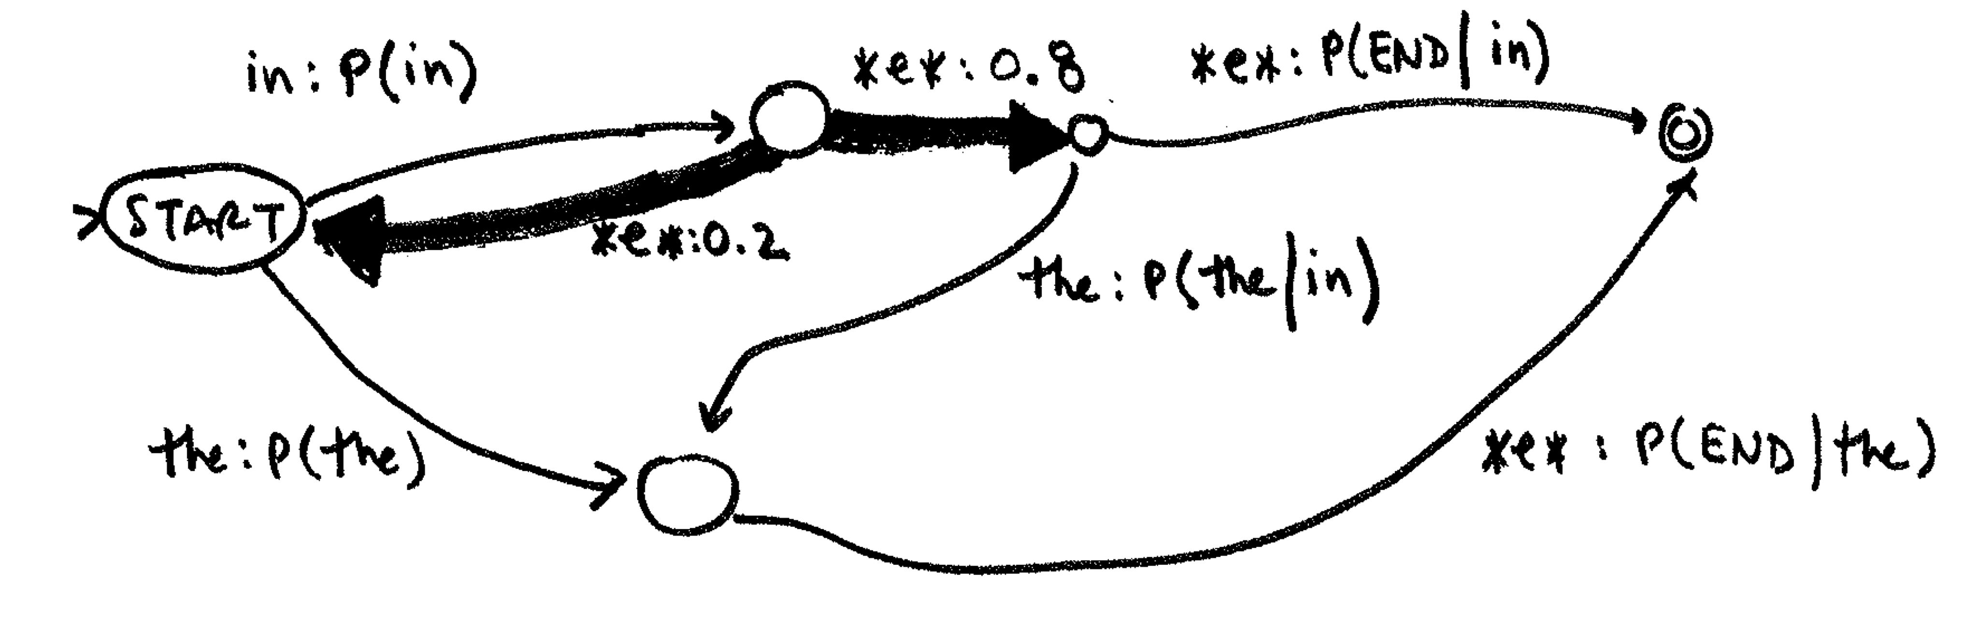
Ngram LM as FSA
from kevin knight

Slide 50
Quiz 4
stack | symbols
[root] a b c e f g | j k l o p
The above table represents a potential configuration during dependency parsing. If we are doing arc-eager parsing, which symbols may be combined in a Left-Arc from this configuration?
f and g
e and f
a and o
g and j
Notes:
g and j; top of stack and front of symbols are used

Slide 51
Quiz 5
stack | symbols
[root] a b c e f g | j k l o p
The above table represents a potential configuration during dependency parsing. If we are doing arc-standard parsing, which symbols may be combined in a Left-Arc from this configuration?
f and g
e and f
a and o
g and j
Notes:
f and g; top two members of the stack are used

Slide 52
Other Approaches To Language Modeling
Maybe we don't always care about the most immediate words
"Show Sally a good ____"
"Show Dave a good ____"
P(time | a good) isn't so great
P(time | Sally a good) isn't really either
P(time | Show Sally a good) isn't helpful for Dave (and backoff/smoothing doesn't really help)
What if we just skipped: P(time | Show ___ a good)
But how much to skip?
We could interpolate different skip models
(doesn't help that much though)

Slide 53
Other Approaches To Language Modeling
Class-based smoothing
Train = ....party on Tuesday ...
Test = ....party on Monday ... ....celebration on Tuesday...
Maybe we could predict classes first, and then words...
Model P(w_{i}=Monday | w_{i-2}=party, w_{i-1}=on)
P(c_{i}=DAY | w_{i-2}=party, w_{i-1}=on) * P(w_{i}=Monday | w_{i-2}=party, w_{i-1}=on, c_{i}=DAY)
Or even drop the words themselves from the conditional
P(c_{i}=DAY | w_{i-2}=EVENT, w_{i-1}=PREP) * P(w_{i}=Monday | c_{i}=DAY)
These generally perform worse than trigram on their own but can help when interpolated

Slide 54
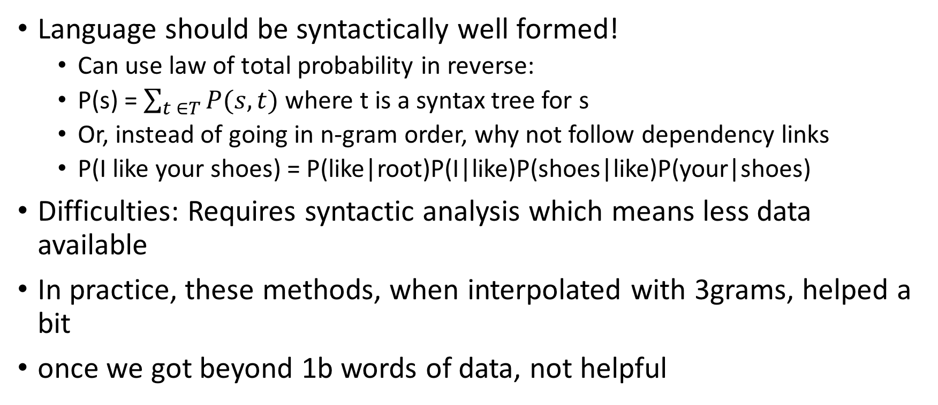
Other Approaches To Language Modeling
Language should be syntactically well formed!
Can use law of total probability in reverse:
P(s) = $\sum_{t ∈T}{P(s,t)}$ where t is a syntax tree for s
Or, instead of going in n-gram order, why not follow dependency links
P(I like your shoes) = P(like|root)P(I|like)P(shoes|like)P(your|shoes)
Difficulties: Requires syntactic analysis which means less data available
In practice, these methods, when interpolated with 3grams, helped a bit
once we got beyond 1b words of data, not helpful

Slide 55
Adding Hidden Information
Maybe there are different types of sentences!
Introductory
Asides
Technical
And each one behaves differently!
If you knew the type of the sentences you could evaluate it with a separate LM estimated off of just that type of sentence

Slide 56
Feature-Based LM
Let's return to perceptron/maxent
Previously we predicted sentiment, word sense, author given an input text
Up to now we've been talking about predicting x_{i} given x_{i-1}, x_{i-2}
Can we model this as a discriminative feature-based model?

Slide 57
𝛟(x)
w(x_{i}=bit)
w(x_{i}=bought)
bias | 1 | .95 | -3.2
x_{i-2}=apple | 0 | .436 | 33.6
x_{i-2}=dog | 0 | -34 | ...
x_{i-2}=cat | 0 | ... | ...
x_{i-2}=the | 1 | 3.4 | 3.6
... | ... | ... | ...
x_{i-1}=apple | 0 | ... | ...
x_{i-1}=dog | 0 | 14.4 | -5.6
x_{i-1}=cat | 1 | 6.3 | -7.8
x_{i-1}=the | 0 | -5 | -17
P(bit | the cat) vs P(bought | the cat)
Kind of like a trigram model!
Note, separate weight for each output type again (too many to evaluate each)
Bias term: a priori preference for that word (unigram prob)

Slide 58
𝛟(x)
w(x_{i}=bit)
w(x_{i}=bought)
bias | 1 | .95 | -3.2
x_{i-2}=apple | 0 | .436 | 33.6
x_{i-2}=dog | 0 | -34 | ...
x_{i-2}=cat | 0 | ... | ...
x_{i-2}=the | 1 | 3.4 | 3.6
... | ... | ... | ...
x_{i-1}=apple | 0 | ... | ...
x_{i-1}=dog | 0 | 14.4 | -5.6
x_{i-1}=cat | 1 | 6.3 | -7.8
x_{i-1}=the | 0 | -5 | -17
... |  | ... | ...
x_{i-2}=NOUN | 0 | ... | ...
x_{i-2}=DET | 1 | ... | ...
x_{i-1}=NOUN | 1 | ... | ...
x_{i-1}=DET | 0 | ... | ...
x_{i-2}=apple ^ X_{i-1}=the | 1 | ... | ...
 |  | ... | ...
P(bit | the cat) vs P(bought | the cat)
As before, we can add arbitrary features
POS tags
word length
initial letter
What about conjuncts of features (true trigram)?
Yes, but this will get very lengthy
Shouldn't the individual units be enough?

Slide 59
Linear models can only separate linearly
Need to add a dimension
with the conjunction of these features!
Good Case
Bad Case

Slide 60
This May Seem Like A Weird Aside!
Don't worry, here's the road map:
N-gram language models ->
Considering other properties ->
Arbitrary feature language models ->
Handling conjuncts of features ->
Stacks of nonlinear perceptron = neural network language models

Slide 61
Solving the XOR problem
Let our features be two dimensional input and the class label one-dimensional output
Can we find W (2x1) and b (2x1) such that the function y = Wx + b solves the problem for this data?
No
But we can use a nonlinear function and map this data into a new, separable feature space!
x1 | x2 | y
1 | 1 | 1
-1 | 1 | -1
-1 | -1 | 1
1 | -1 | -1

Slide 62
Mapping into a new space
x space
b
a
step(x1*h_{x1}+x2*h_{x2}+b)
h1 mapper
a: step(1+1-1) = 1
c
d
x1 | 1
x2 | 1
b | -1
b: step(-1+1-1) = -1
c: step(-1-1-1) = -1
d: step(1-1-1) = -1
x-space data
step function:1 if > 0, else -1
h space
 | x1 | x2 | y
a | 1 | 1 | 1
b | -1 | 1 | -1
c | -1 | -1 | 1
d | 1 | -1 | -1
c
h2 mapper
a: step(-1-1-1) = -1
x1 | -1
x2 | -1
b | -1
b: step(1-1-1) = -1
c: step(1+1-1) = 1
b
d: step(-1+1-1) = -1
d
a

Slide 63
New ('hidden') space to output space
c
h space
b
c
b
a
d
a
o mapper
d
h1 | 1
h2 | 1
b | 1
h-space data
 | h1 | h2 | y
a | 1 | -1 | 1
b | -1 | -1 | -1
c | -1 | 1 | 1
d | -1 | -1 | -1
a: step(1-1+1) = 1
step(h1*o_{h1}+h2*o_{h2}+b)
b: step(-1-1+1) = -1
c: step(-1+1+1) = 1
d: step(-1-1+1) = -1

Slide 64
Another way of looking at these matrices
raw inputs go here
x1 | 1
x2 | 1
b | -1
output values come here
h1 mapper
raw inputs go here
o mapper
h1 | 1
h2 | 1
b | 1
h2 mapper
x1 | -1
x2 | -1
b | -1

Slide 65
Quiz 6
stack | symbols
[root] a b c e f g | j k l o p
What is the resulting configuration after an arc-standard Left-Arc?
stack | symbols
[root] a b c e f | g j k l o p
stack | symbols
[root] a b c e f | j k l o p
stack | symbols
[root] a b c e f g j | k l o p
stack | symbols
[root] a b c e g | j k l o p
stack | symbols
[root] a b c f g | j l o p
Notes:
g head, f dropped

Slide 66
Quiz 7
stack | symbols
[root] a b c e f g | j k l o p
What is the resulting configuration after an arc-eager Right-Arc?
stack | symbols
[root] a b c e f | g j k l o p
stack | symbols
[root] a b c e f | j k l o p
stack | symbols
[root] a b c e f g j | k l o p
stack | symbols
[root] a b c e g | j k l o p
stack | symbols
[root] a b c f g | j l o p
Notes:
g head, j pushed

Slide 67
Announcements
HW4: due today. You can use all your late days if you want (applies to this hw only)
Please check calendar for rest of HWs
Exam Friday
SoCal ML symposium Friday
Drop Deadline Friday
Extra Office Hour Today?
Hyper-Piazza-Awareness

Slide 68
Midterm Info
Some of you will
NOT BE IN SAL 101
YOU WILL BE
IN MHP (Mudd) 101

Slide 69
Backoff Bigram LM as FSA

Slide 70
Backoff Bigram LM as FSA

Slide 71
Backoff Bigram LM as FSA

Slide 72
Backoff Bigram LM as FSA

Slide 73
Backoff Bigram LM as FSA

Slide 74
Backoff Bigram LM as FSA

Slide 75
What Has This To Do With Language Models?
Toy example:
x1 (think "feature 1") can have value 1 or -1
x2 can have value 1 or -1
outcome can be 1 or -1
given training data (a, b, c, d), can we use perceptron to learn o from features?
no. If we added x3 ("x1 xor x2") we could. But we saw we could add layers and a nonlinear function and now use conjuncts of these features

Slide 76
What Has This To Do With Language Models?
LM example:
x1 can be 'wn-1=dog' (1 or 0)
x2 can be 'wn-1 = the' (1 or 0)
...
x24657 can be 'wn-4 is adjective'
we can have x2947502393 be "wn-1=dog ^ wn-2=the" but we can also use multi-layer structure to get that for 'free'
for o, we'd like to know what we think about each word. So have an o for each word.

Slide 77

But we want probabilities here
Recall what we did for logistic regression
$$\frac{\text{exp}(w^{T}φ\left(x\right))}{\sum_{x^{′}∈X}{\text{exp}(w^{T}φ\left(x′\right))}}$$
AKA "softmax"

Slide 78
=P(o1|input)
=P(o2|input)
So, given an input
(features extracted from ngram context)
if properly weighted, this gives a probability
distribution over output words
Done for each word in a sentence we get
a probability of the sentence
This is a language model!

Slide 79
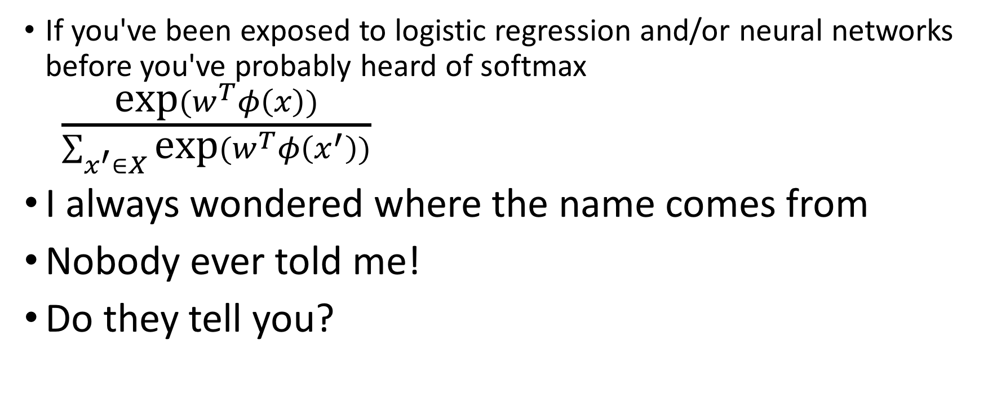
Aside: Softmax
If you've been exposed to logistic regression and/or neural networks before you've probably heard of softmax $\frac{\text{exp}(w^{T}φ\left(x\right))}{\sum_{x^{′}∈X}{\text{exp}(w^{T}φ\left(x^{′}\right))}}$
I always wondered where the name comes from
Nobody ever told me!
Do they tell you?

Slide 80
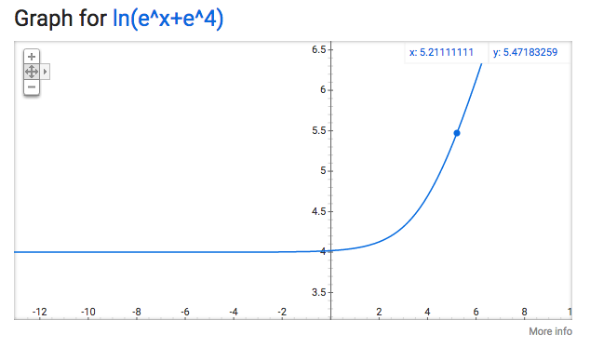
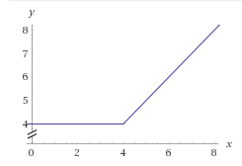
Max and softmax functions
the softmax function is defined as is a "soft" approximation of max
softmax(x, y, z) = ln(e^{x}+e^{y}+e^{z})
max(4, x)
softmax(4, x)
from Abishek Patnia, via Quora

Slide 81
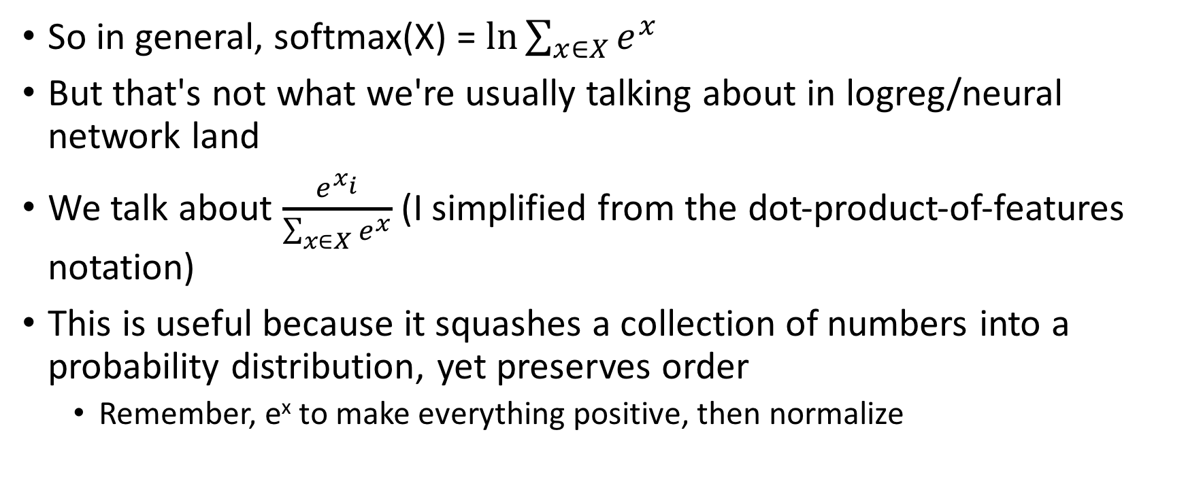
Softmax vs softmax activation
So in general, softmax(X) = $\text{ln}\sum_{x∈X}{e^{x}}$
But that's not what we're usually talking about in logreg/neural network land
We talk about $\frac{e^{x_{i}}}{\sum_{x∈X}{e^{x}}}$ (I simplified from the dot-product-of-features notation)
This is useful because it squashes a collection of numbers into a probability distribution, yet preserves order
Remember, e^{x} to make everything positive, then normalize

Slide 82
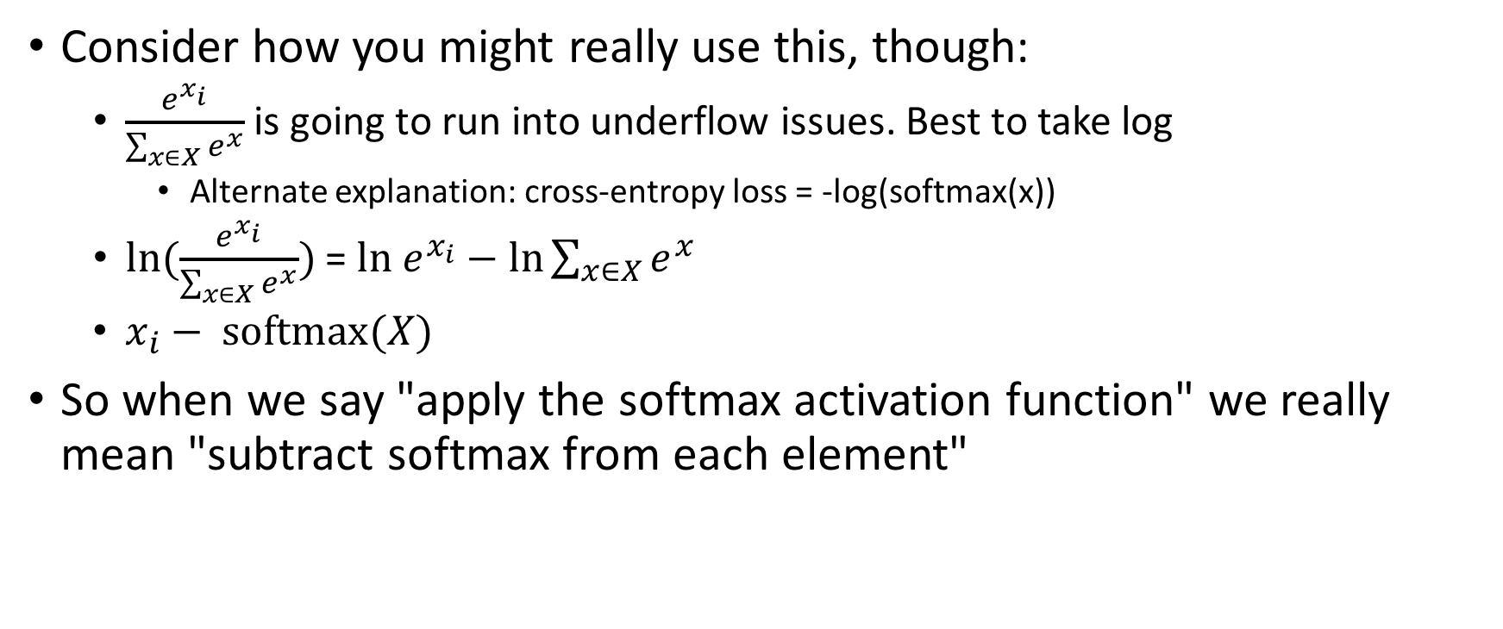
Softmax vs softmax activation
Consider how you might really use this, though:
$\frac{e^{x_{i}}}{\sum_{x∈X}{e^{x}}}$ is going to run into underflow issues. Best to take log
Alternate explanation: cross-entropy loss = -log(softmax(x))
$\text{ln}(\frac{e^{x_{i}}}{\sum_{x∈X}{e^{x}}})$ = ${\text{ln} e}^{x_{i}}−\text{ln}\sum_{x∈X}{e^{x}}$
$x_{i}− \text{softmax}(X)$
So when we say "apply the softmax activation function" we really mean "subtract softmax from each element"

Slide 83
Quiz 8
stack | symbols
[root] a b c e f g | j k l o p
What is the resulting configuration after an arc-standard Right-Arc?
stack | symbols
[root] a b c e f | g j k l o p
stack | symbols
[root] a b c e f | j k l o p
stack | symbols
[root] a b c e f g j | k l o p
stack | symbols
[root] a b c e g | j k l o p
stack | symbols
[root] a b c f g | j l o p
Notes:
f head, g popped

Slide 84
Quiz 9
stack | symbols
[root] a b c e f g | j k l o p
What is the resulting configuration after an arc-eager Left-Arc?
stack | symbols
[root] a b c e f | g j k l o p
stack | symbols
[root] a b c e f | j k l o p
stack | symbols
[root] a b c e f g j | k l o p
stack | symbols
[root] a b c e g | j k l o p
stack | symbols
[root] a b c f g | j l o p
Notes:
j head, g popped (note; same config as standard right)

Slide 85
How Do We Set The Weights?
For the very simple xor case we set the 9 weights by hand
But the general problem has lots of parameters!
Fear not, we can use the same approach we used before:
Define a loss (how bad was our decision vs reality?)
Calculate the gradient (derivative w/r/t our parameters)
Adjust parameters, to move away from the gradient
Try again with more data, until we find something good

Slide 87
Training Setup
truth
=.023
1
=.532
0
w₁, ..., w_{i-1}
=.0002
0
...

Slide 88
Loss
A common one is squared error: (y_{truth}-y_{hyp})²
gradient = 2(y_{truth}-y_{hyp}) y_{hyp}'
y is a vector (one entry per output vocab member)
Note: 2(y_{truth}-y_{hyp}) > 0 for truth, <0 else
= move toward the good thing, away from the bad
Ok, so what's y_{hyp}?
hyp
truth
.023
1
.532
0
.0002
0
(scalar, given)
(result of equation;
function of parameters)

Slide 89

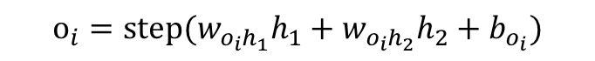
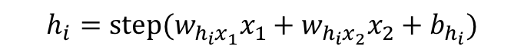
Back to the Ugly Graph
$$y_{i}=\frac{e^{o_{i}}}{e^{o_{1}}+e^{o_{2}}}$$
$$h_{i}=\text{step}(w_{h_{i}x_{1}}x_{1}+w_{h_{i}x_{2}}x_{2}+b_{h_{i}})$$
$$o_{i}=\text{step}(w_{o_{i}h_{1}}h_{1}+w_{o_{i}h_{2}}h_{2}+b_{o_{i}})$$
y is pretty complicated! Need to differentiate w/r/t each parameter
y contains step function: not differentiable at 0 and =0 elsewhere!
tanh is a nicer approximation

Slide 90
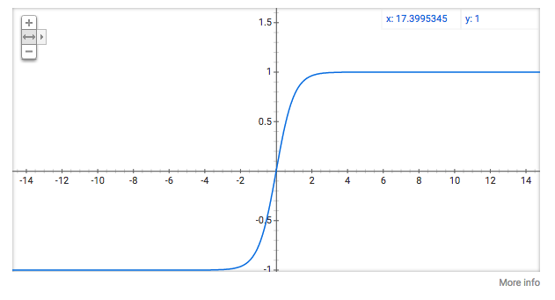
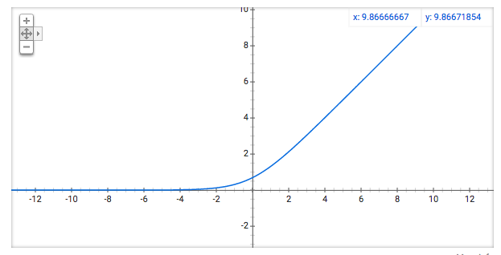
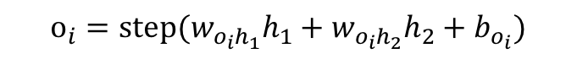
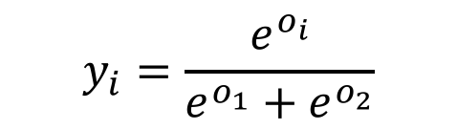
Making differentiable
tanh
$$h_{i}=\text{step}(w_{h_{i}x_{1}}x_{1}+w_{h_{i}x_{2}}x_{2}+b_{h_{i}})$$
tanh
$$y_{i}=\frac{e^{o_{i}}}{e^{o_{1}}+e^{o_{2}}}$$
$$o_{i}=\text{step}(w_{o_{i}h_{1}}h_{1}+w_{o_{i}h_{2}}h_{2}+b_{o_{i}})$$
tanh
y is pretty complicated! Need to differentiate w/r/t each parameter
y contains step function: not differentiable at 0 and =0 elsewhere!
tanh is a nicer approximation
Can also use ReLU (or softplus = softmax(x, 0))
softplus

Slide 91
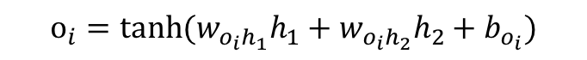
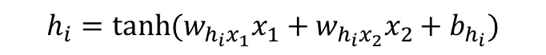

Differentiating
gradient = 2(y_{truth}-y_{hyp}) y_{hyp}'
y_{truth} given; y_{hyp} found by propagating data through the messy function
y_{hyp}'? lots of partials
dy/dw_{oh} = dy/do do/dw_{oh}
dy/db_{o} = dy/do do/db_{o}
dy/d_{hx} = dy/do do/dh dh/dw_{hx}
dy/db_{h} = dy/do do/dh dh/db_{h}
$$h_{i}=\text{tanh}(w_{h_{i}x_{1}}x_{1}+w_{h_{i}x_{2}}x_{2}+b_{h_{i}})$$
$$y_{i}=\frac{e^{o_{i}}}{e^{o_{1}}+e^{o_{2}}}$$
$$o_{i}=\text{tanh}(w_{o_{i}h_{1}}h_{1}+w_{o_{i}h_{2}}h_{2}+b_{o_{i}})$$

Slide 92
Good News: You don't really have to worry about it!
Auto-differentiation: topologically calculate values forward, derivatives backward
Partial values stored at each cell; dynamic programming makes it all efficient
Implemented in e.g. tensorflow, theano, Dynet

Slide 93
What Should We Connect? What Features Should We Use?
Motivation was bigram features via structured perceptron
So just connect the unigrams for adjacent words together?
i.e. all w₁=... to all w₂=...
seems like a lot of careful planning
What about similar word-class behavior?
Maybe all days should function similarly
Or all animals
Maybe we can characterize a single word by a set of features
But which features?
Letter it starts with?
Part of speech?
Class?
Idea: let the learning figure out how to assign features; we just choose the number of features

Slide 94
Feed-Forward Neural Language Model
Fully connected
"Embeddings" shared
Embedding cell 14:
animate noun(?)
hidden cell 44:
topic is business (?)
from J&M v3

Slide 95
Updates
Midterm, HW3 and HW4 being graded
I'll go over midterm questions throughout the next several classes (not today)
Will not be on your copy of slides
Today: Finish LMs, then Lexical Semantics
Friday: Distributional Semantics, HW5 (should be easier than HW4)
Next 2 weeks:
Wednesday: Guest Lecture Nanyung Peng (Information Extraction)/No JM office hours
Friday: JM in town, regular office hours. 10/20 = MT 0; 10/27 = Daniel Marcu

Slide 96
Embed
Hidden
Output
w_{i-k}
w_{i}= basketball
...
...
w_{i}=the
P(w_{i}=the|w_{i-k}, ..., w_{i-1})
...
w_{i-1}
...
An n-gram language model!

Slide 97
FF Neural LMs: Very competitive!
Trained on 14m words of AP news; Vocab = 16,000
From Steve Renals

Slide 98
P(w_{i}= ... | w_{i-1}, w_{i-2})
w_{i-2}
(transition)
Equivalent
to pFSA!
w_{i-1}
n-1^{|V|} unique
hidden vectors = states
Each state has transition
to |V| states
"I've just seen w_{i-2}
followed by w_{i-1}"
(state)

Slide 99
h_{i-1}
P(w_{i}= ... | w_{i-1})
=P(w_{i}= ... | h_{i-1})
w_{i-1}
"I've just seen w_{i-1}"
For a Feed-Forward model,
next step is to change w_{i-1}
What if the hidden layer
was also part of the input?

Slide 100
h_{"I"}
P(w_{i}= ... | "I")
=P(w_{i}= ... | h_{"I"})
"I"
Sentence = "I threw the ball"

Slide 101
h_{"I threw"}
P(w_{i}= ... | I threw)
h_{"I"}
=P(w_{i}= ... | h_{"I threw"} )
"threw"
Sentence = "I threw the ball"

Slide 102
h_{"I threw the"}
P(w_{i}= ... | I threw the)
h_{"I threw"}
=P(w_{i}= ... | h_{"I threw the "} )
"the"
Sentence = "I threw the ball"

Slide 103
h_{"I threw the ball"}
P(w_{i}= ... | I threw the ball)
h_{"I threw the"}
=P(w_{i}= ... | h_{"I threw the ball "} )
P(w_{i}= STOP | I threw the ball)
"ball"
Sentence = "I threw the ball"

Slide 104
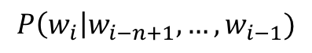
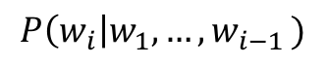
Feed-Forward NN LM
n-1 gram
context
$$P\left(w_{i}\right|w_{i−n+1}, …, w_{i−1})$$
"finite state"
$$P\left(w_{i}\right|w_{1}, {…,w}_{i−1})$$
Recurrent NN LM
w_{i-1}
"infinite state"

Slide 105
RNN LMs: Even More Competitive!
Trained on Penn Treebank (~1m words)
On more realistic language sizes (~1b words) RNNs take weeks to train
KN models take only hours

Slide 106
RNN Notes
Training: "Unroll" the RNN and propagate on the unrolled graph
Issues: Vanishing and exploding gradients
Gradients for hidden layer are multiply multiplied; as we calculate the influence of a word's far past, gradients can get very close to 0 or very large; either way no learning is done
More complicated RNNs (LSTM, GRU) are employed to limit this
More complex layers, but still elementary differentiable operations that can be backpropagated.

Slide 107
'Unreasonable Effectiveness of RNNs'
Andrej Karpathy built a nice RNN (actually LSTM) setup and trained it on lots of data, one character at a time
Then he generated samples from the trained models (choose the next word proportional to the probabilities)
Results were surprisingly good!

Slide 108
Shakespeare
PANDARUS:
Alas, I think he shall be come approached and the day When little srain would be attain'd into being never fed, And who is but a chain and subjects of his death, I should not sleep.
Second Senator:
They are away this miseries, produced upon my soul, Breaking and strongly should be buried, when I perish The earth and thoughts of many states.
DUKE VINCENTIO:
Well, your wit is in the care of side and that.
Second Lord: They would be ruled after this chamber, and my fair nues begun out of the fact, to be conveyed, Whose noble souls I'll have the heart of the wars.
Clown: Come, sir, I will make did behold your worship.
VIOLA: I'll drink it.

Slide 109
Wikipedia
== ''Declaration of Protectance from Iceland'' ==
In the late 1970s, [[Deep Seols]] and the Australian Federal Navy in order to establish a police duty of a several federal government of the world.
Since 2004 the state regarded as a [[Suffolk Act 1994]], but the [[Army personality|Armed Forces]] appeared in Paris, despots with Nelson concentrated on) was inaugurated as his father. Heraldry put an attempt to get influent territory register. Hayling among their lost operations, a population of Deliberate countries arrived and Harry Elser, established [[The West Virasian Socialist Wars]] for 16 year and modern democratic 30 [[Justice|booms]] elections to the CDC.

Slide 110
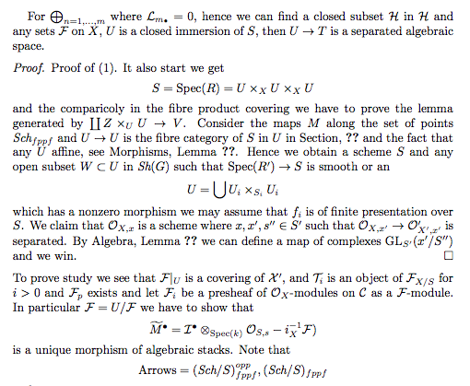
LaTeX (They had to fix some compile bugs)

Slide 111
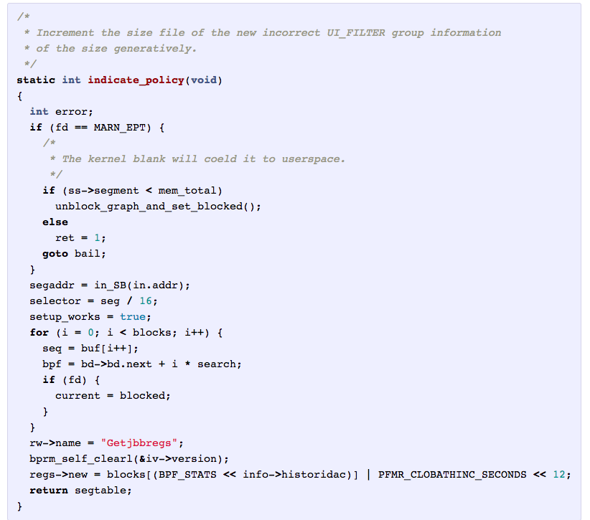
Unix Source Code

Slide 112
Other generators people tried
Names of death metal bands/new pokemon/Paint (including samples)
Recipes
Bob Dylan lyrics
Obama/Trump tweets
Try it yourself!
http://karpathy.github.io/2015/05/21/rnn-effectiveness/
https://github.com/crisbal/docker-torch-rnn

Slide 113
LM Summary
Most LMs use limited prior-word context
Estimated from large corpora of language
Intrinsic evaluation with perplexity
Critical parts of generation-based downstream applications
Historically, trick has been to be good at estimating unseen events, via smoothing, backoff
Neural Feed Forward N-gram language models handle unseen events well
RNNs don't even need to make the n-gram markov assumption
Despite their power, neural models train very slowly

Slide 114
LogReg vs. FF Neural example
http://cs231n.github.io/neural-networks-case-study/
http://cs.stanford.edu/people/karpathy/cs231nfiles/minimal_net.ipynb

